Slide 1


Slide 2
Conference Theme
Guided Pathways: Lea(r)ning into future trends
Our College is engaging in three (3) system-level changes:
Fostering equitable outcomes in all of our professional practices;
Designing and evaluating Guided Pathways; and
Successfully implementing ctcLink.
These change initiatives require our ability to hone our skills in the following Essential Practices:
Change: how well we prepare for and adapt to equity-focused changes that occur within the organization and how well we support one another and work together.
Growth: the extent to which we create equitable opportunities to develop and advance both for ourselves and for others at Clark College and our community.
Engagement: the level of emotional and intellectual commitment we have towards our jobs and whether we have the right skills and resources to make a valuable and equitable contribution.
Readiness: the extent to which we have the skills, abilities, willingness, and knowledge to implement change with an intentional focus on equity.
Goal-setting: how well we know, own and can impact our success and the success of Clark College by connecting our contributions to the overall goals of the College.
Notes:
Welcome to Teaching and Learning Days. Clark is engaged in 3 system-level changes including “successfully implementing ctcLink” Today’s session focuses on both change and readiness – because having information and seeing the system helps to reduce anxiety and provide you with information to be ready for our transformation to PeopleSoft.

Slide 3
  ctcLink Orientation introducing 'Fluid'
Today Agenda
  Go Live Date
  When do we have access to PeopleSoft?
  Clark’s ctcLink teams site
  SBCTC Reference Center
  Canvas courses
    How to access Canvas
  How will I know what to do?
  How will students know what to do?
  UAT and live environments
  Introducing Fluid
  Logging in and navigation
    Landing page & Gateway
    Fluid navigation
    Left navigation
    Classic navigation
  Self Service
    Employee
    Faculty
    Student
  Advisor Center

Slide 4
10 – 28 – 2019
74 days to GoLive
Notes:
Are go live date is Oct 28, which is only 74 days away.

Slide 5
When do we have access to PeopleSoft?
Sunday 10/27 | Monday 10/28 | Tuesday 10/29 | Wednesday 10/30 | Thursday 10/31
SMES | Legacy Super Users | Non Legacy Users |  | Students
EC | Supervisors | Faculty Advisors |  | ECD Students
IT Service Center | Administrative Support | Faculty
Tech Hub | Club Advisors
Notes:
Groups will receive an email with the link to be able to sign in as a new user. Reminder – write down that PS ID when you see it, or else you will need to call the help desk.
Students will not access the system until Thursday. This allows time for staff to review student records and enter any data as necessary.

Slide 6
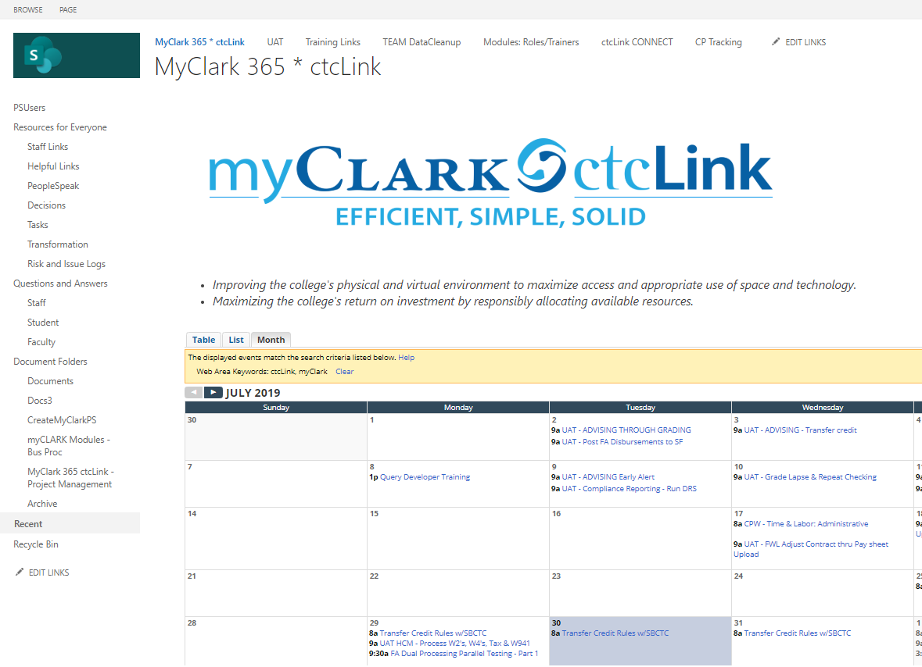
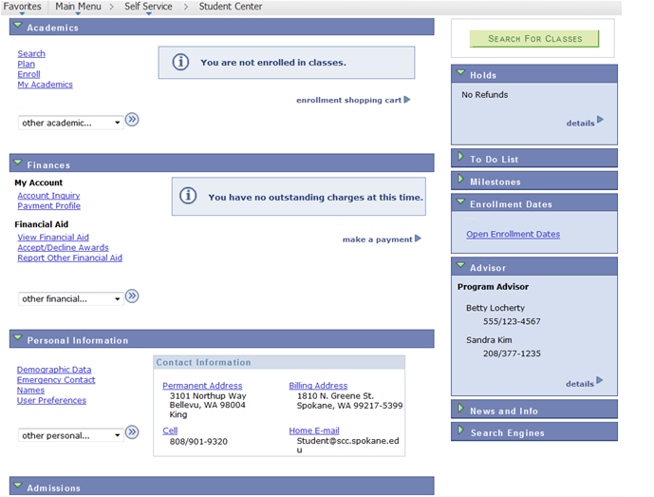
  Clark’s ctcLink teams site myClark 365
All employees can access the ctcLink team site. Here you will find:
Calendar with all upcoming ctcLink related events
PS Users
  Information on how to sign into Canvas
  Legacy to PeopleSoft Glossary
Resources
  Staff links
  Helpful Links
  People speak – ctcLink terminology
Question and Answers
  Answers to some of the most common questions around ctcLink
Documents Folders
  Create MyClark PS
  myClark Modules – Bus Processes
  Project Management
Notes:
Clarks ctcLink Project team created myClark 365. This is a SharePoint site that has all ctcLink related information including a calendar of ctcLink related event.
Show them the site and walk through how to find things like canvas links, resources, PM documents, Training schedule

Slide 7
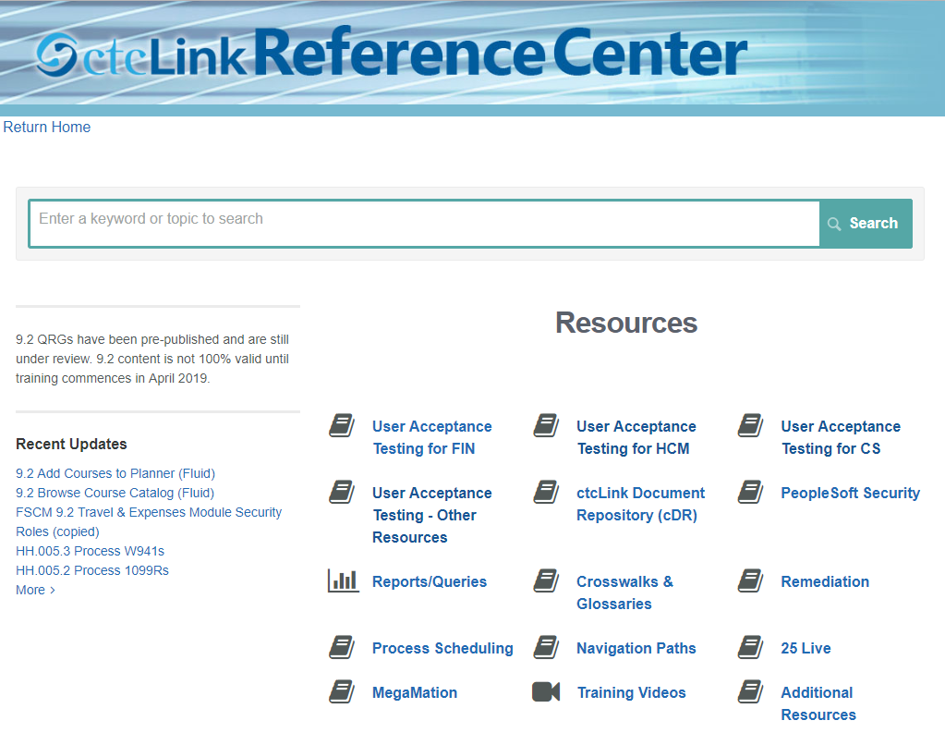
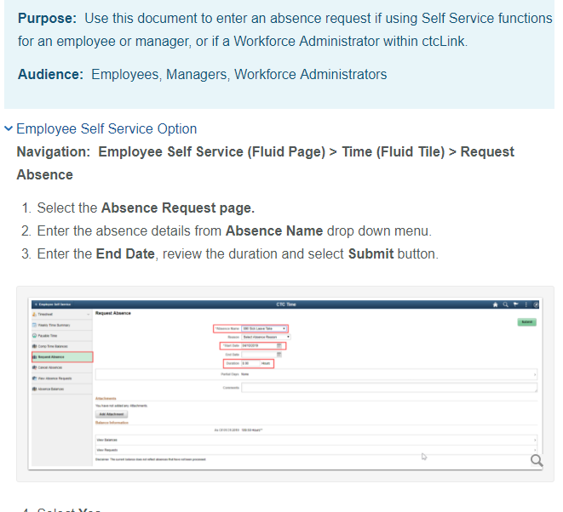
  SBCTC Reference Center http://ctclinkreferencecenter.ctclink.us/
SBCTC Reference Center:
QRG’s – Quick Reference Guides Provide step by step instructions
UAT – User Acceptance Testing
Test scripts and scenarios
Training Videos
Notes:
SBCTC created ctcLink Reference Center. This is the state boards resource for ctcLink information like quick reference guides (guides to walk you through ow to do specific processes. It also has all UAT test scenarios and training videos.

Slide 8
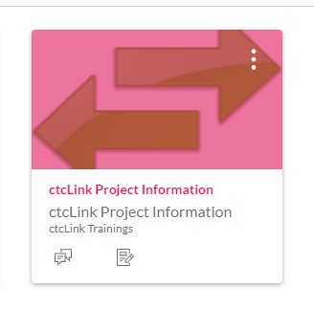
  Canvas Courses
ctcLink Project Information: Deployment Group 2 (DG2):
  Self Enroll into PeopleSoft Fundamentals
  Global Design Review Session GDR - Archived
  Business Process Fit/Gap (BPFG)
  Conversion Validation & Crosswalks
  Parallel & Dual Processing
Notes:
The state board has utilized Canvas for providing information for all deployment groups. Deployment groups are current and upcoming implementation groups. Clark is in DG2 (deployment group 2). The ctcLink Projection information course provides access to self enroll into PeopleSoft Fundamentals, the first place everyone needs to start at prior to accessing end user trainings is PeopleSoft fundamentals. You can access past global design review session and fit/gap sessions her as well.

Slide 9
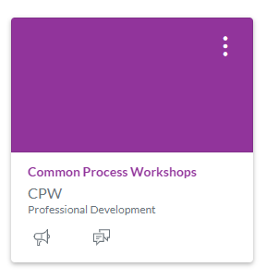
  Canvas Courses
Common Process Workshops
  Common Process Modules
  Guided Pathway Requirements Gathering
  End User Training
    Starts September
Clark College Canvas
Notes:
The another SBCTC canvas course is Common Process Workshops course, here is where all documentation from the common process workshops can be found. You can find information on decisions that where made at the global level of ctcLink.
To access the canvas courses go to Clark College canvas page and login. If you have never logged in click on the how to log in link and follow those direction. If you still cant login click on help and then report a problem. Once you get access to canvas if you don’t see the ctcLink tiles contact me and I can get you invited to the courses.

Slide 10
How will I know what to do?
Instructor led classes, by SBCTC staff via WebEx
Self-paced course in Canvas
ctcLink Reference Center – Quick Reference Guides (QRG)
Videos
Open Labs
Clark led classes
Ask a SME
Notes:
There are many ways available to you to learn about PeopleSoft. We are in the process of scheduling multiple upcoming sessions. Susan will talk about these more tomorrow in the keynote speaker session at 11:00

Slide 11
How will students know what to do?
Email
Videos on website
MyClark ctcLink Quick Reference Guides
Open Labs
Tech Hub available in Gaiser
MyClark Triage Center
College 101
Notes:
How will student know what to do?
Beginning of fall term we will begin communications to students. At GoLive we will have a variety of resources available. Susan is giving a presentation on What to Expect in PeopleSoft – Student Focus today and if you are interested in getting a copy of her PowerPoint let me know and I can arrange that.

Slide 12
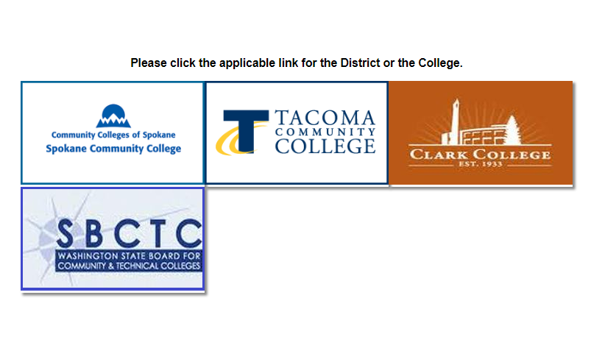
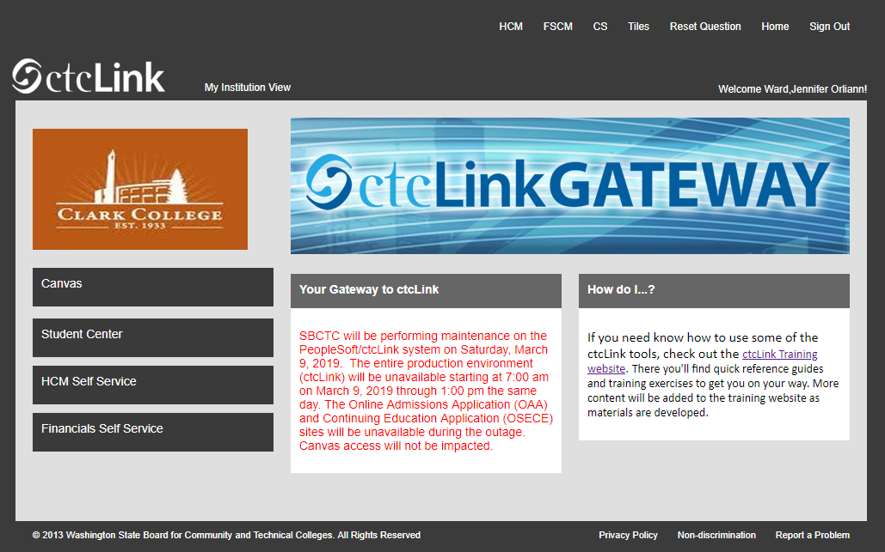
  UAT and Live Environments
UAT Environment
  Staff have been busy testing end to end processes
  UAT environment is using Fluid pages
Live Environment
  Staff have been working in the Live environment setting up AAR’s, Fall and Winter courses and classes and Transfer Credit Rules
Notes:
Currently we have staff at Clark working in two different environments, UAT and Live

Slide 13
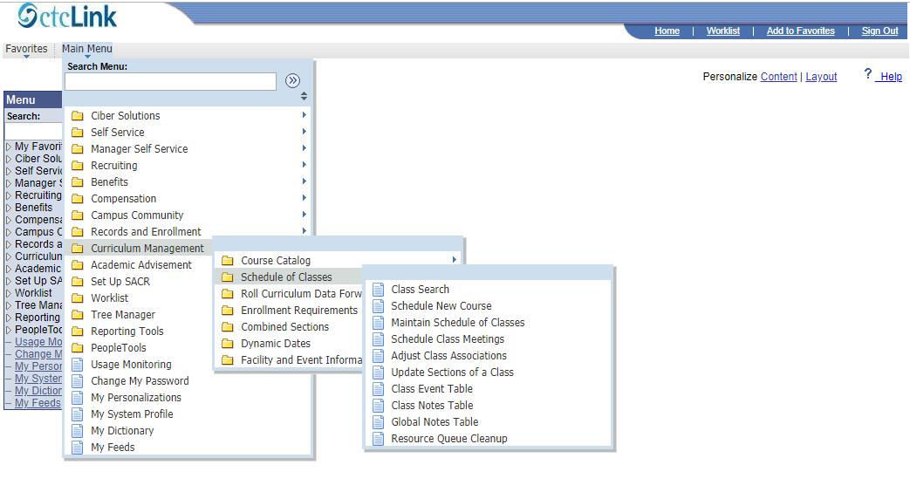
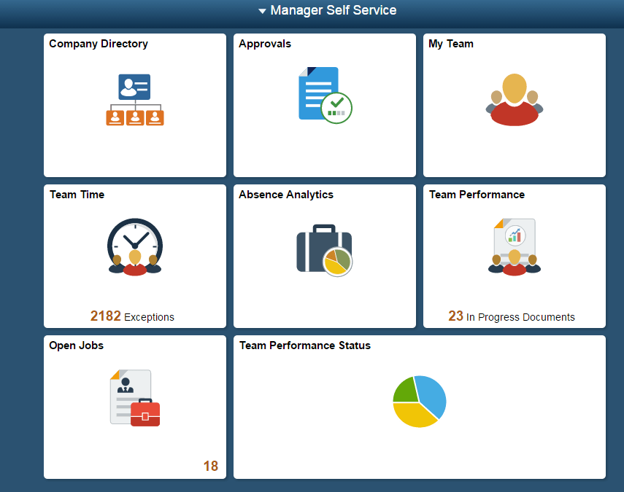
  Introducing Fluid in ctcLink
ctcLink PeopleSoft has two user interfaces:
  ctcLink PeopleSoft Classic User Interface, which was designed to be used on a laptop and desktop.
  ctcLink PeopleSoft Fluid User Interface, which was designed to be used on mobile devices, but can also be used on a laptop and desktop.
ctcLink PeopleSoft application reads the type of device you are using and renders the page accordingly.
However, not all pages utilize the Fluid interface.

Slide 14
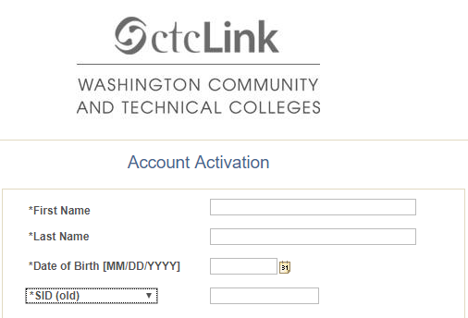
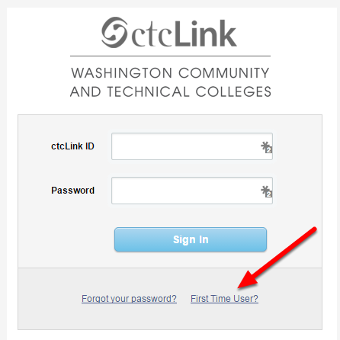

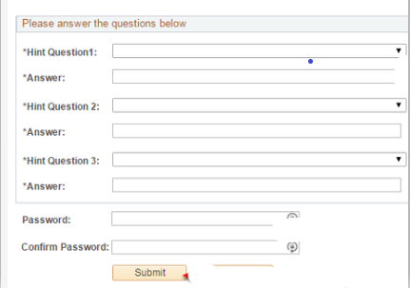
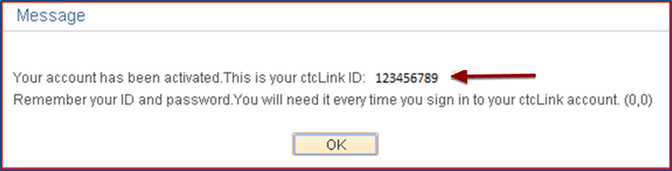
  Logging Into ctcLink
  – for the first time
ctcLink – Live
First time logging in and activating you ctcLink Account
  Click on First Time User
  Enter Required information
  Change ctcLink ID to SID (old)
  Answer Security Questions
  Write down your ctcLink ID
Notes:
When logging in for the first time you will need to click on “First Time User” Once you do that a new window opens. You need to fill in each box and in the drop down select *SID (old), this will be your current SID. Once you do that you will answer security questions and click submit. That is when the message box will display. This is the only time you will see your ctcLink ID. Be sure to copy or write it done. You will need this ID and password to login in going forward.

Slide 15

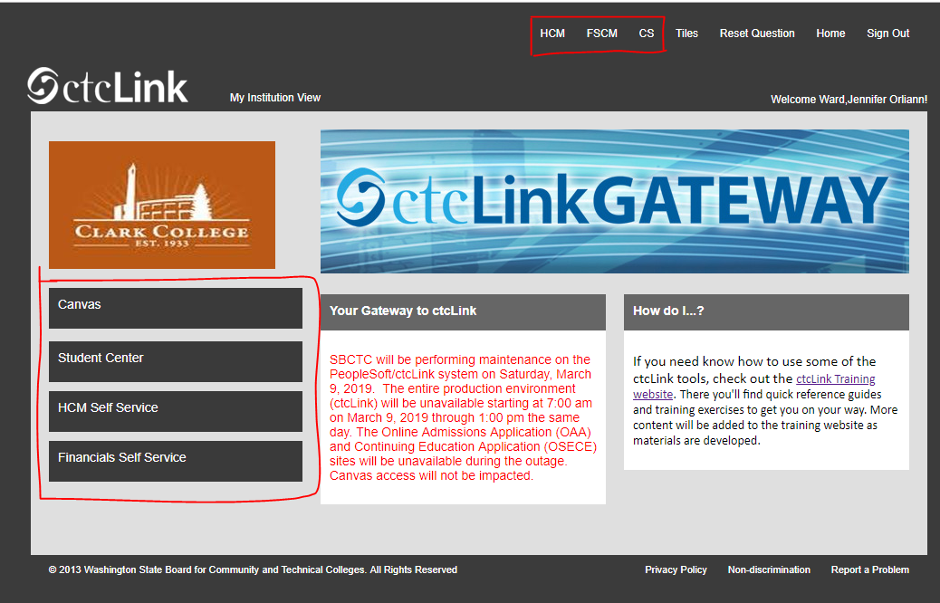
  Logging Into ctcLink
Landing Page:
Once logged in this is first page you will see. Here you select your college
ctcLink GATEWAY:
On this page you have a few options:
Left Navigation is self service navigation
Top Navigation is for accessing the 3 pillars
Notes:
Once you login you will come to the first landing page. On this page you select the Clark College logo (Susan is working on having this updated to a better logo.
After clicking on the logo the ctcLink Gateway is displayed. Here is where you will access one of the 3 pillars or the self service are

Slide 16
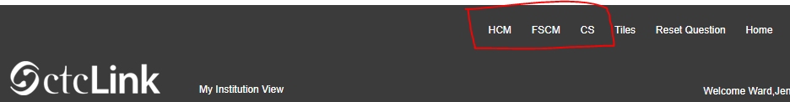
  ctcLink Fluid Navigation
Top Pillar Navigation Menus:
  HCM – Human Resources
  FSCM – Finance
  CS – Campus Solutions
Notes:
To access the three pillars you would select one from the top of the ctcLink gateway page. Depending on your security roles on if you will see only one pillar or possibly all 3.

Slide 17
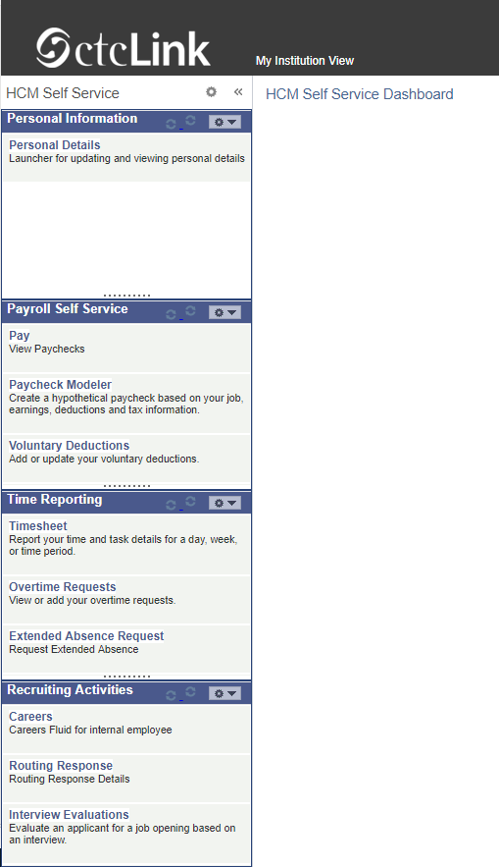
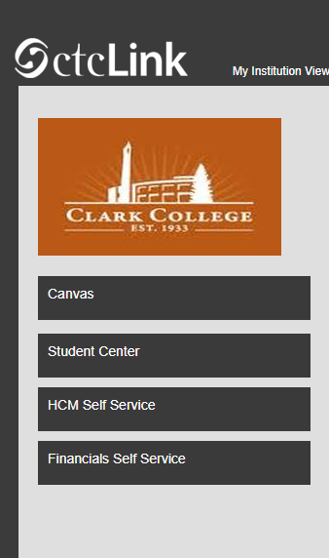
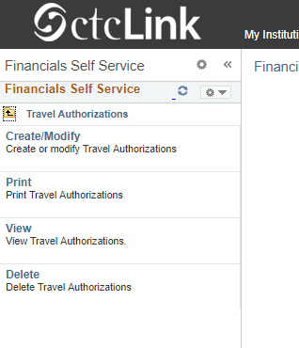
  ctcLink Fluid Navigation
Left Self Service Navigation:
HCM Self Service
  Personal information
  Payroll Self Service
  Time Reporting
Financials
  Expense Report
  Travel Authorizations
Notes:
The left navigation is for self service features. Here you have access to your HCM records including time reporting and payroll self service features. You can complete travel request and voucher through the finance link. If you are a current student you can also access your student information and canvas courses through the left navigation links.

Slide 18
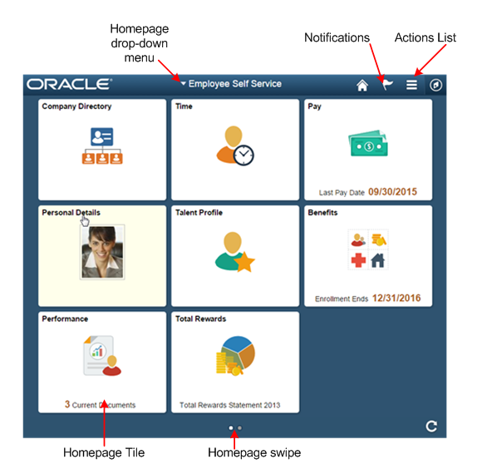

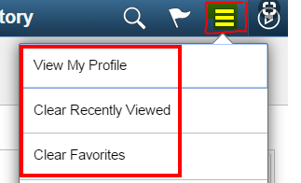
  ctcLink Fluid Navigation
Homepage:
Homepages are the starting point for navigation in Fluid.
  A user can have several homepages and one default homepage that is displayed after login.
  Homepage has flag for notifications
  Action list
Notes:
Homepages are the starting point for navigation in Fluid. You have the ability to create multiple homepages with one as your default page. You can access each page from the drop down at the top of the screen.
The flag Icon will let you know if you have Alerts (notifications) or Actions (task) waiting for you.
The Action list is where you go to customize your home screens.

Slide 19
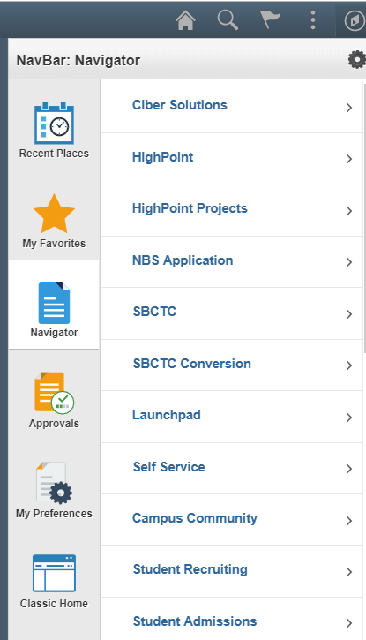
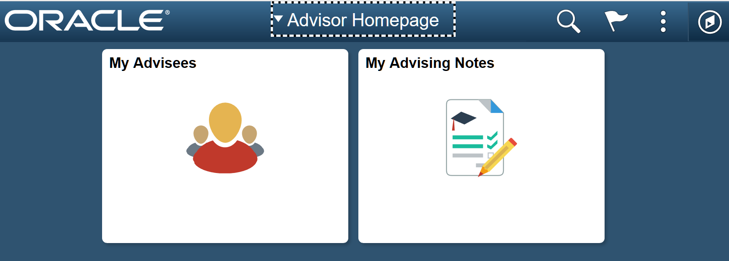
  ctcLink Fluid Navigation
Navigation within the pillars can be done utilizing tiles or NavBar: Navigator
  Fluid homepages contain tiles that users can view for high-level information and completing tasks
  The Fluid Navigation Bar (NavBar) is used to access additional navigational options. The NavBar can be personalized to add, remove, or alter the sequence in which the tiles appear.

Slide 20
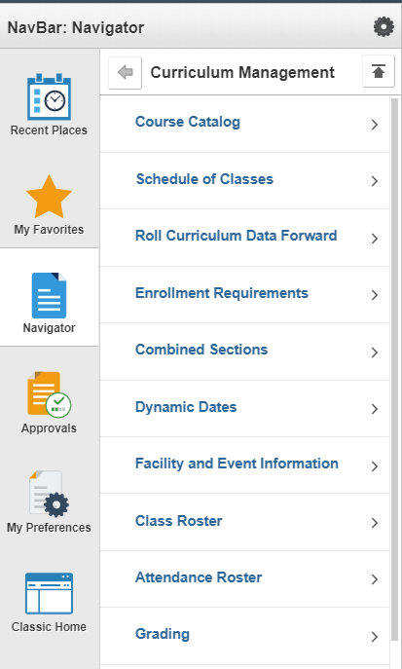
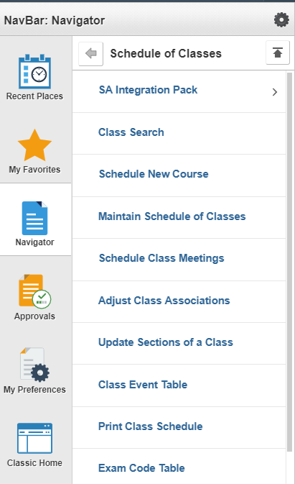


  ctcLink Fluid Navigation
Fluid Navigation:
NavBar is to optimize navigation for the end-user and allow them to quickly and easily navigate.
  You have tiles in the NavBar for quick navigation
    Recent Places
    My Favorites
    Navigator – Opens up navigator to access all components
  This example show you the navigation to Schedule of classes
  In classic Navigation you have breadcrumbs in fluid you have levels
    This example shows 3 levels in navigator
    To go back one layer you would click on
    To return to beginning you would clink on
Notes:
A few years ago Dani Bundy presented a ctcLink orientation and one of the items she focused on was breadcrumbs and how they made the navigation easier. With the new fluid environment you no longer have breadcrumbs in the traditional format that Dani talked about. In fluid through the navigator you can accomplish the same thing.
You can navigate to the page you are looking for and if you need to go back you can easily accomplish that via the arrows on the navbar.
One thing that still rings true from Dani orientation is the back arrow/button on you browser. You do not want to use your browsers back and forward arrows. These can cause you to be kick out of ctcLink. Always navigate utilizing the NavBar or tiles. Once you are to a page and you decide you want to go back open navigator and use the back arrow to go back on page or the up arrow to return to the NavBar home page.

Slide 21

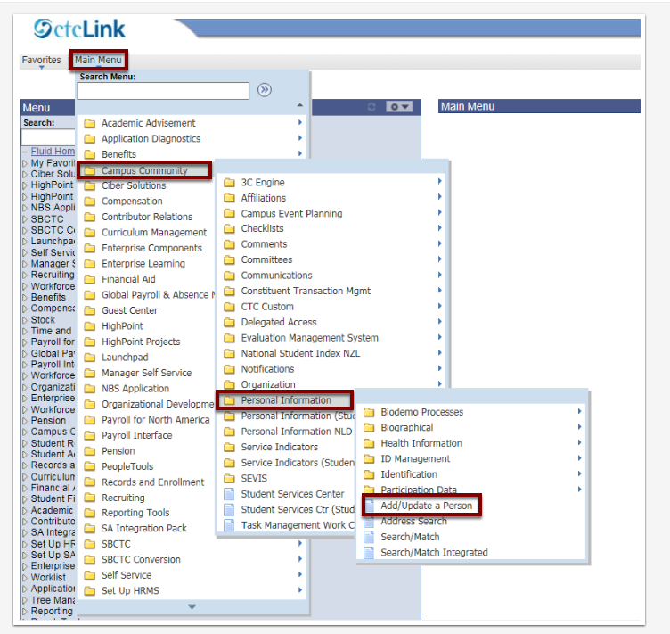
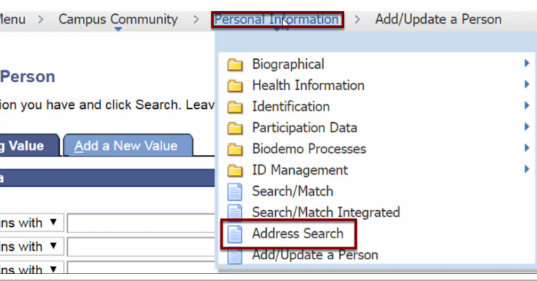
  ctcLink Classic Navigation
Classic Navigation in PeopleSoft –
Using Breadcrumbs
  When navigating to a page, the navigation path is displayed next to the Main Menu. This is called a breadcrumb trail.
  This example will show the navigation as: Main Menu > Campus Community > Personal Information > Add/Update a Person
  Menu selected from navigation path (Breadcrumb trail), showing sub menus
Notes:
There are still pages within ctcLink that utilize the classic navigation. When you are in these pages you will see the classic breadcrumb navigation. Currently the live environment is still using classic navigation. Part of the DG2 implementation is switching the current live environment to the FLUID environment. SBCTC is working to make all pages FLUID.

Slide 22
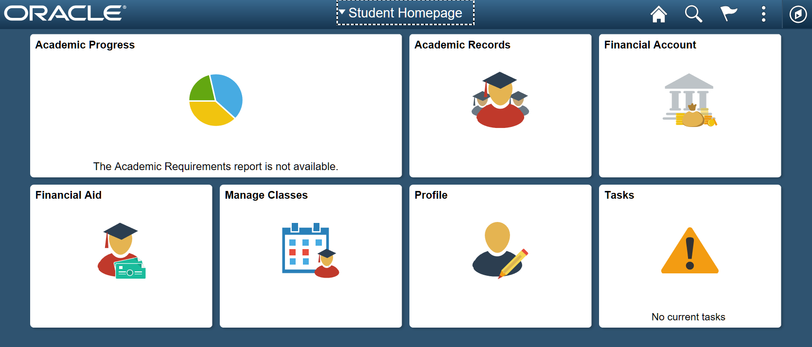
Student Self Service
Students can manage their college business online:
  See holds
  Enroll for classes
  Edit personal information
  Check registration dates
  Review their academic plan
  Check on Financial Aid
  Pay tuition
  Request a transcript
  Contact program advisor
Notes:
I presented a quick overview of the new FLUID environment but I also would like to show you some of the self service menus in ctcLink. These areas are still being built out in the new FLUID environment so I cant show you them in the system but wanted to give you a little introduction to them.
In student Self Service student will have the ability to update their personal information, check on registration dates, see communications from the college and register and pay for courses. Student will have more access to their school records and information then they had before.

Slide 23
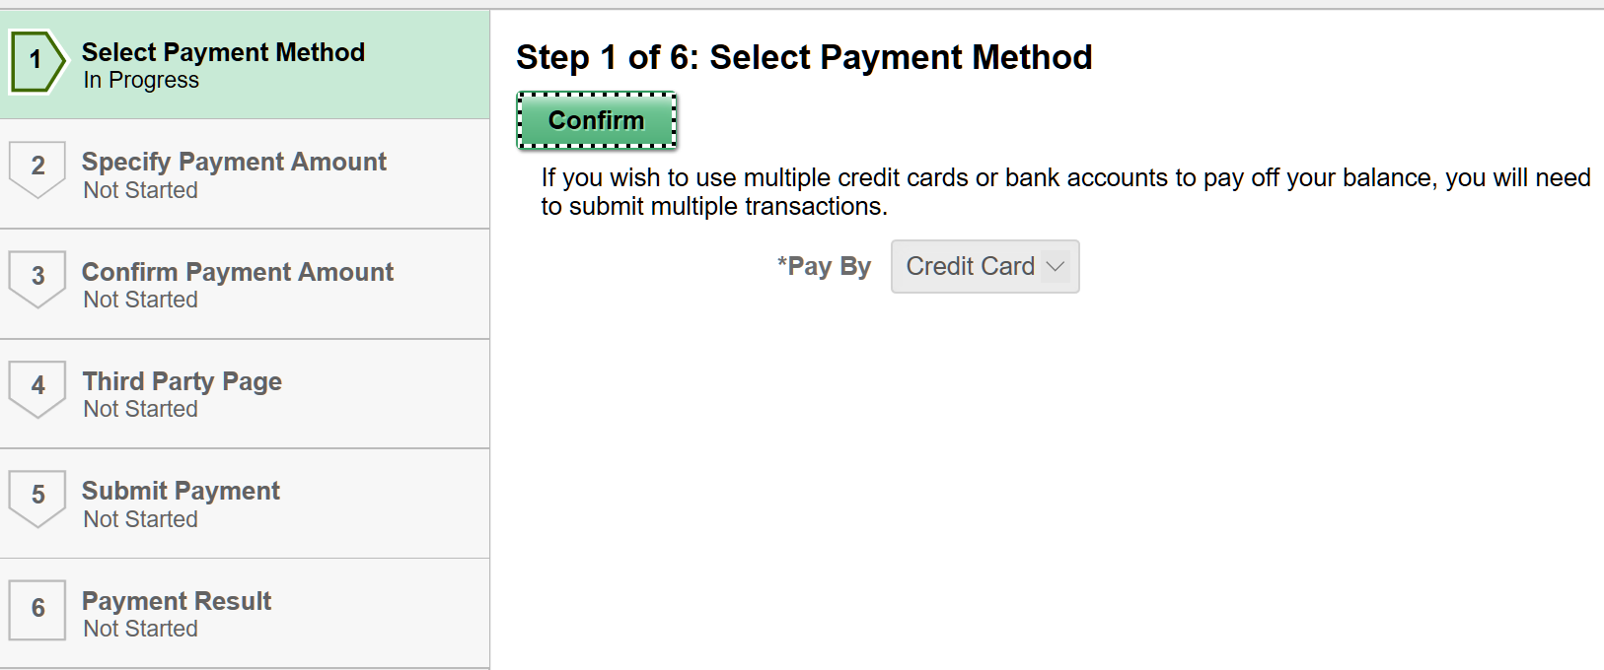
Student Self Service – Activity Guide
Activity Guides:
Activity Guide enables you to create a multi-step guided task. Each action item can have a start date/time and due date/time and has a status value (for example, Assigned, In Progress, and Completed). You can define:
  The dependencies between action items, for example, action item A must be completed before a student starts action item B.
  Whether an action item is required or optional, that is, whether the action item must be completed in order to complete the task.
  The processing that the system should perform when a student completes an action item.
Notes:
One of the features that staff are excited about is the Activity guides. Staff can create student task that are dependent upon completion of previous steps. They can make items required or optional and have due dates that are tracked.
The student can view and access their open active tasks. Tasks are ordered by due date ascending, and if due date is same then the ordering is done alphabetically by title. If there are no pending tasks, the page displays a message: “No current tasks”. The student can view but cannot access their completed tasks in the Completed Tasks page.

Slide 24
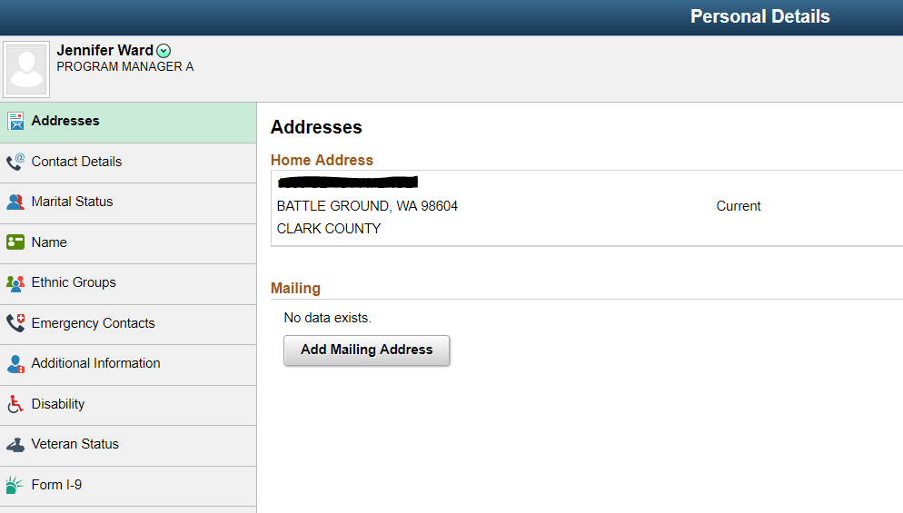
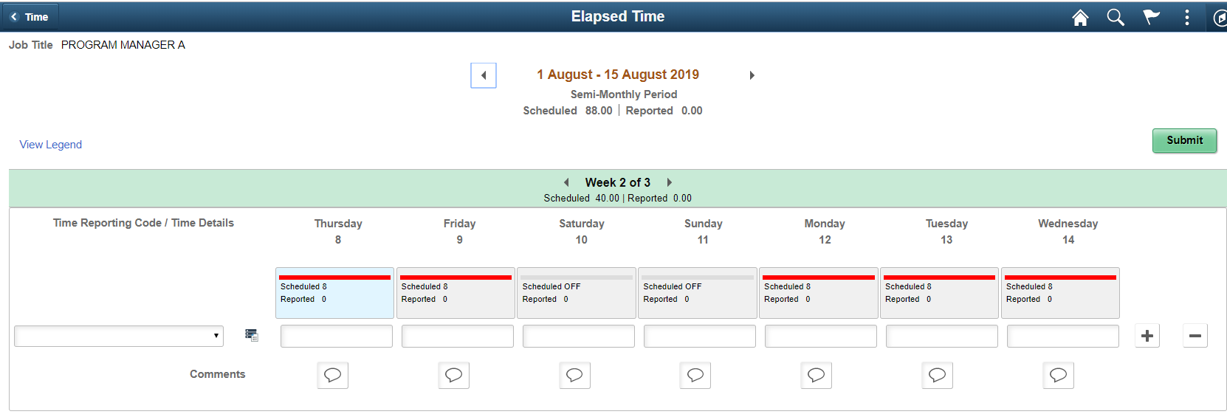
Employee Self Service
Employees can manage their college business online.
Employees can:
  Edit and update personal information
  Review benefits summary and dependent coverage
  Change their W4 form
  Request leave
  Report time
  Request, maintain and update training and development
Notes:
In Employee self service employees can submit time sheet, change W4 withholding, update personal information and see all their benefit information. You will have more access to your employee records then we currently have. Tomorrow Susan is the 11:00 am Keynote speaker and will be presenting on What to Expect with MyClark ctcLink – Employee focused.

Slide 25
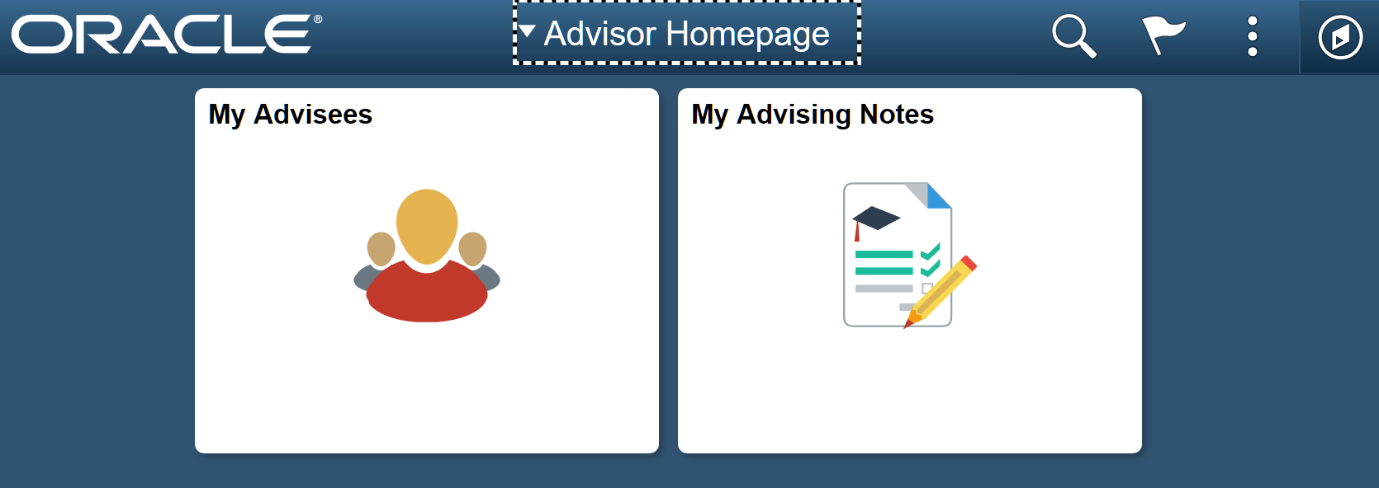
Advisor Center
Advisor Center:
A one-stop shop for advisors to access students’ academic records.
Notes:
Advisor centers will provides advisors with the tiles they need for advising. Same for Faculty and managers.

Slide 26

Questions?

